Slide 1

Credit Card Financial Dashboard
Md. Lutful Kabir
June 2024
Linked In: https://www.linkedin.com/in/mdlutfulkabir/

Slide 2
Objective
To develop a comprehensive credit card weekly dashboard that provides real-time insights into key performance metrics and trends enabling stakeholders to monitor and analyze credit card operations effectively

Slide 3
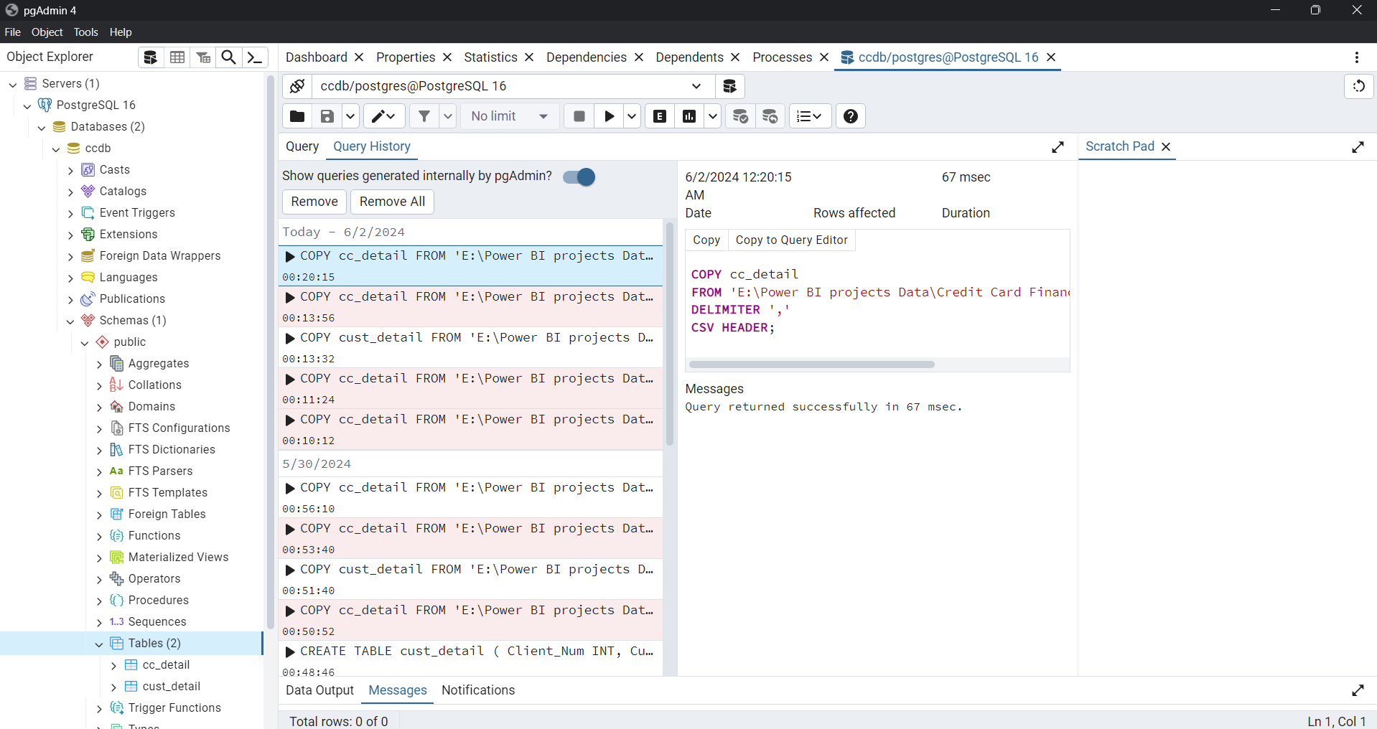
Data was collected from online open-source platform.
Then it was imported in SQL server using PostgreSQL.
After that the SQL server was connected to the Power BI. From there it was imported to the Power BI dashboards.
If the SQL server data updates then the dashboard updates after refreshing the data in Power BI.
Data collection
And update data

Slide 4
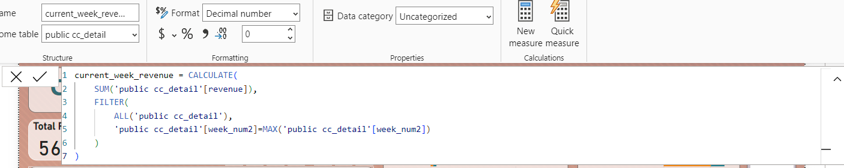
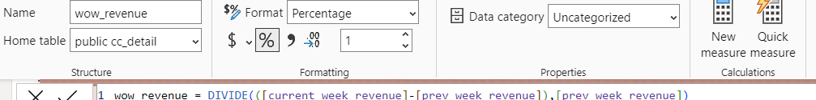
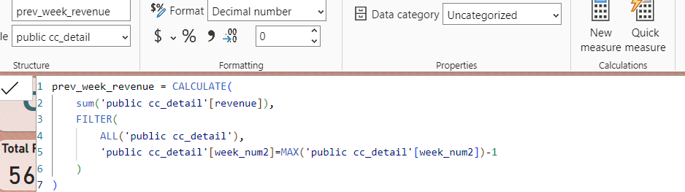
DaX
Queries
Screenshot

Slide 5
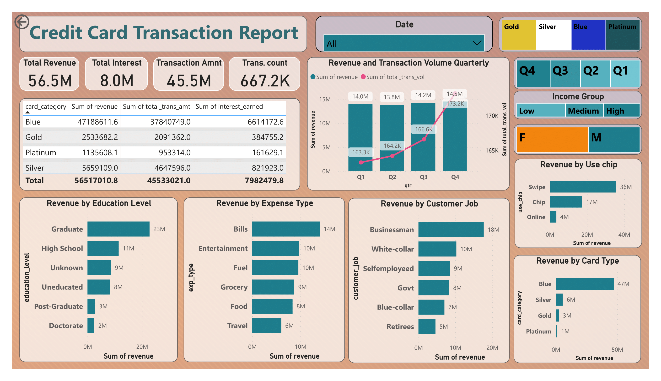

Slide 6
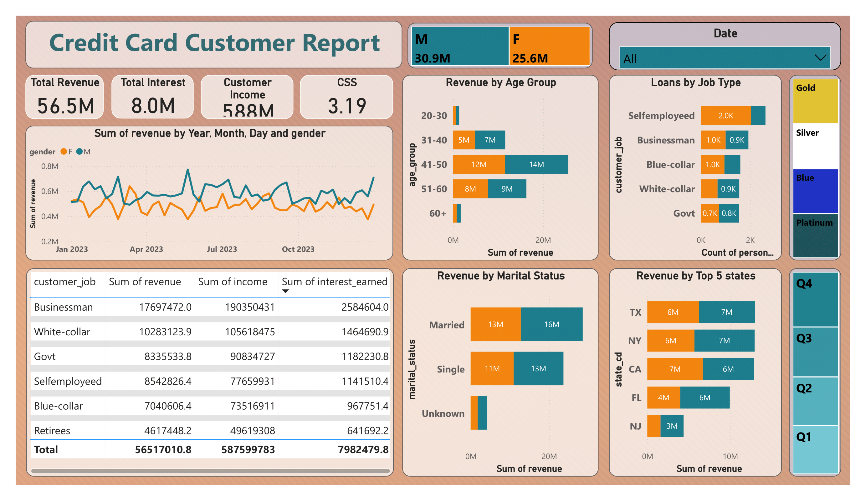

Slide 7
Week on Week change
Revenue increase by 28.8%
Total Transaction Amount & Volume increased by 35% and 3.4%
Customer count increased by 12.8%
Insights-
Week 53
(31st December)
Overview of year to year change
Overall revenue 56.5 Million
Total interest is 8 Million
Total Transaction amount is 45.5 Million
Male customers are contributing more in revenue.
Blue and Silver Credit Card holders are contributing 93% of overall transaction
TX, NY and CA is contributing to 68%
Overall Activation rate is 57.5%
Overall Delinquent rate is 6.06%

Slide 8
End
Thanks

